Slide 1

IRPersonalNews
Università degli Studi di Milano Bicocca
Dipartimento di Informatica, Sistemistica e Comunicazione
Corso di Laurea Magistrale in Informatica
Information Retrieval Personalized News System
Final report of
Andrea Guzzo
Matricola: 761818
Academic year: 2019-2020

Slide 2
Table of Content
Introduction
Introduction
Architecture
Steps: Indexing, Retrieval, Personalization
Conclusion

Slide 3
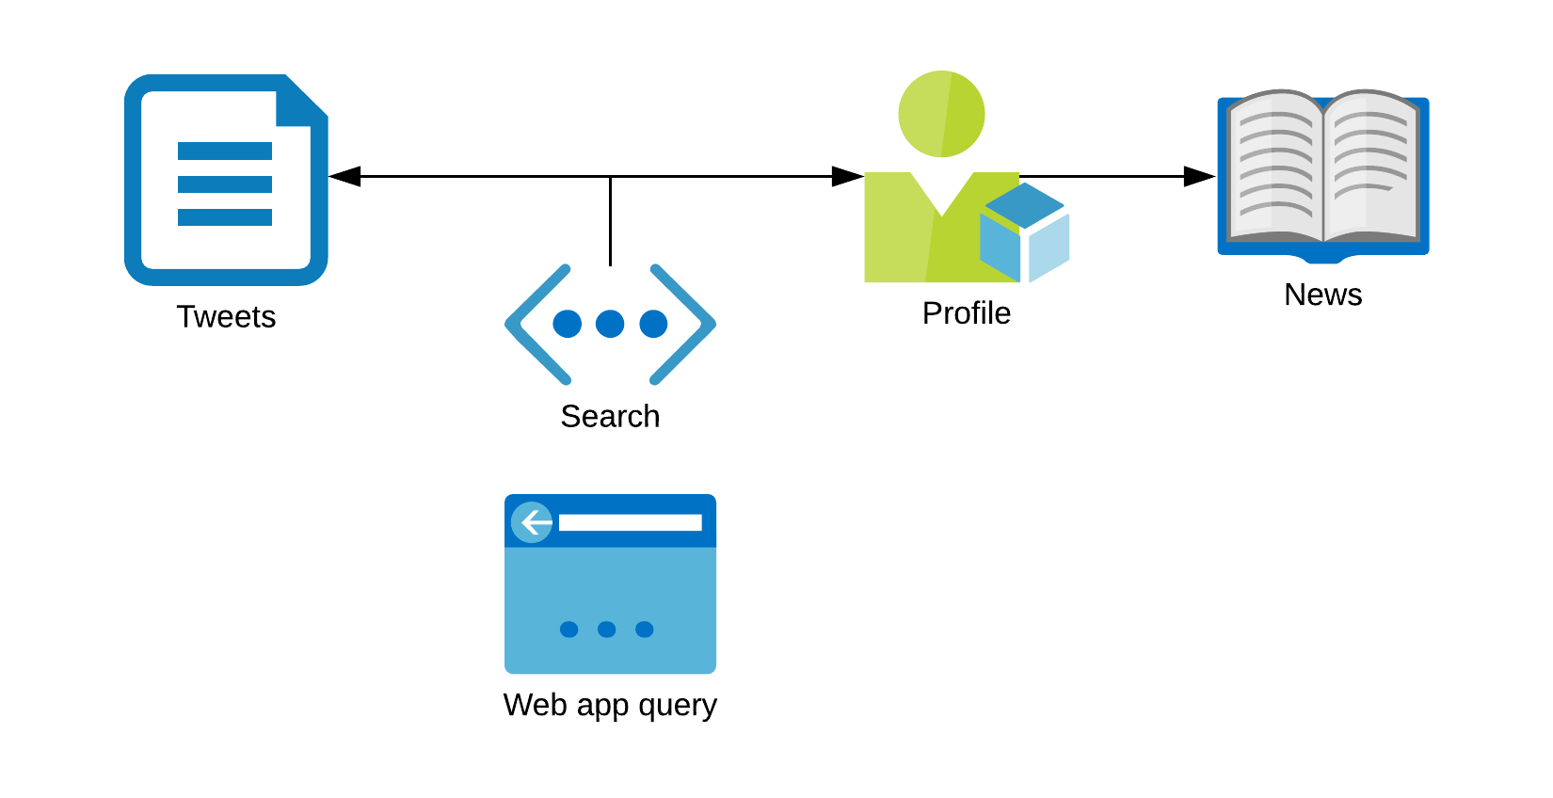



Introduction
Introduction
Webapp Recommended System for retrieving and searching tweets based on custom user profile built from past news reading.
https://github.com/JeyDi/IRPersonalNews

Slide 4
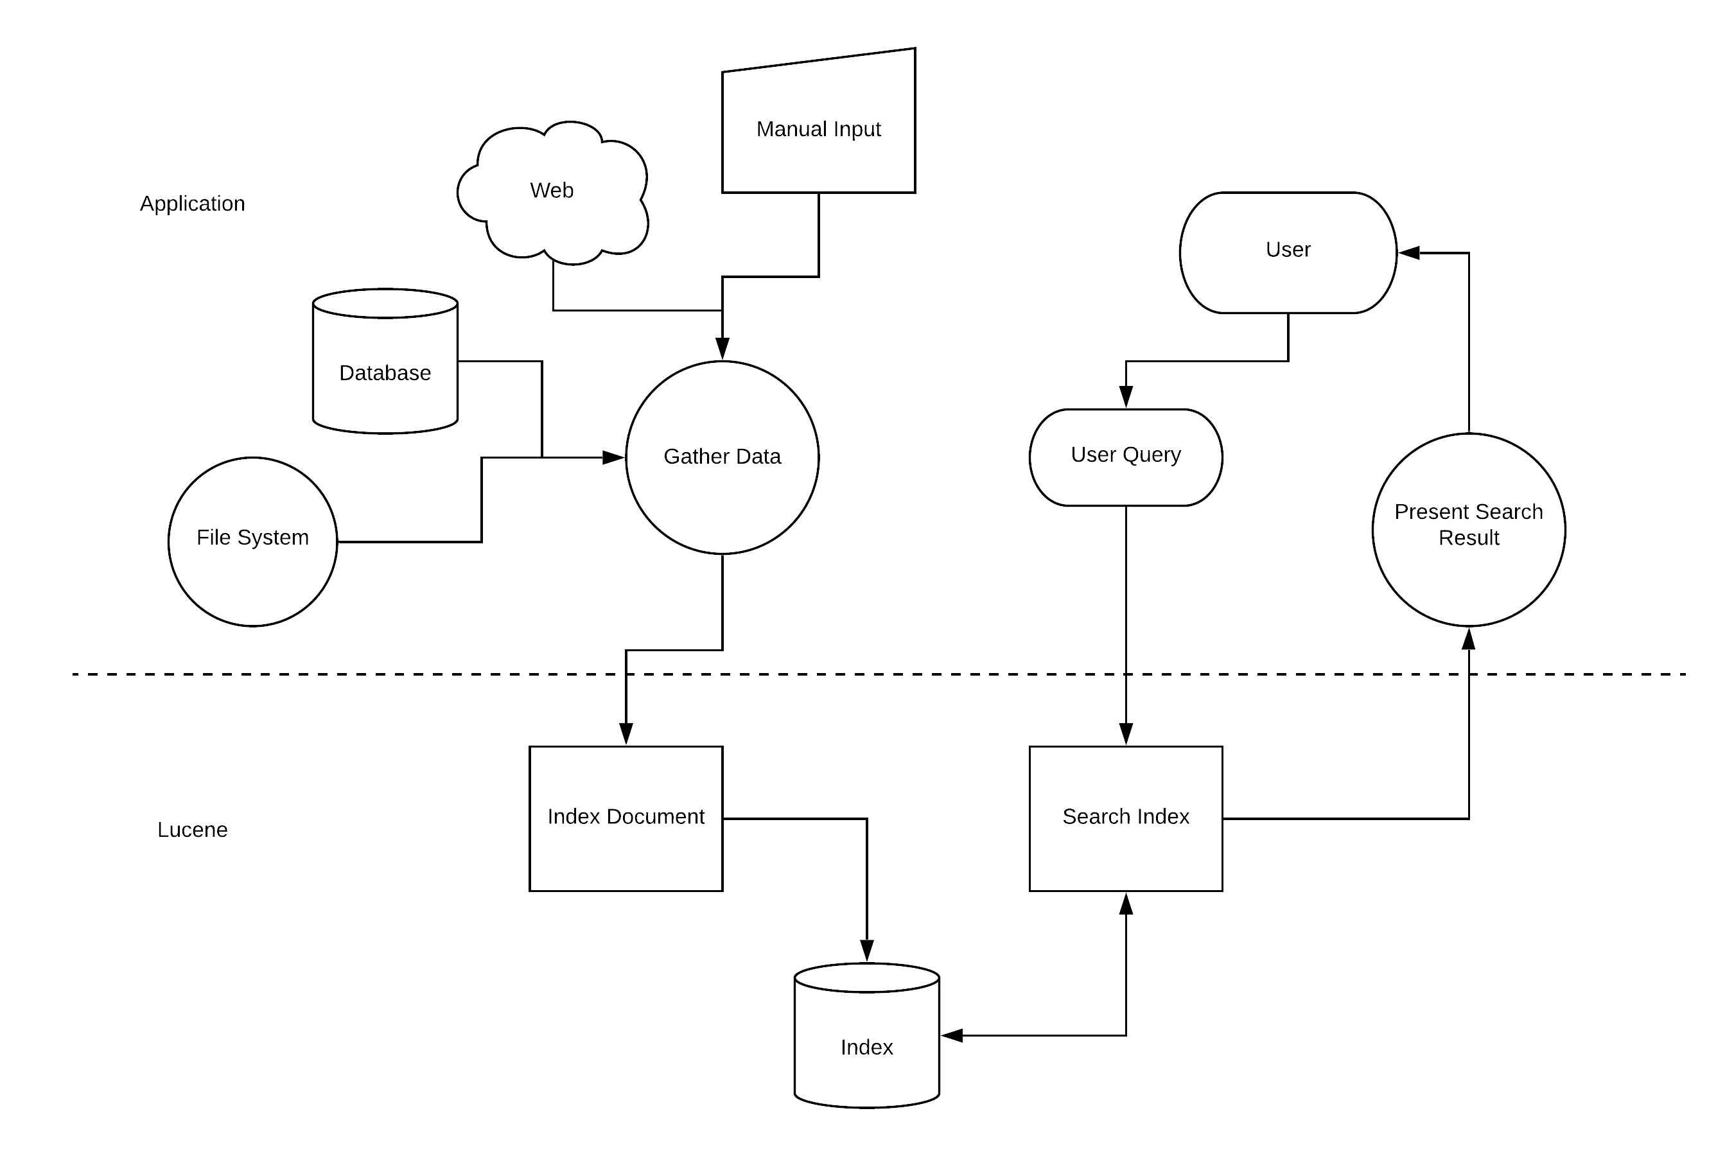
A Generic Recommended System
Introduction

Slide 5
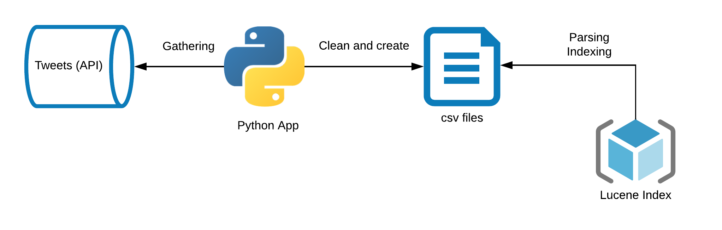
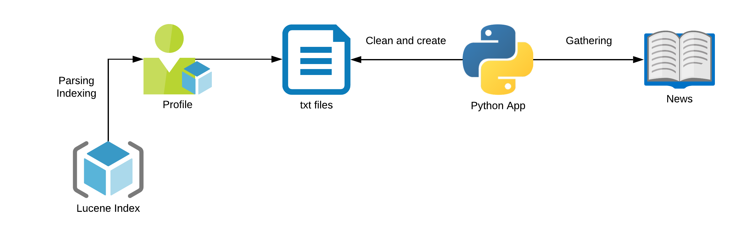
Data
Introduction
Tweets Gathering Pipeline
News Gathering Pipeline

Slide 6
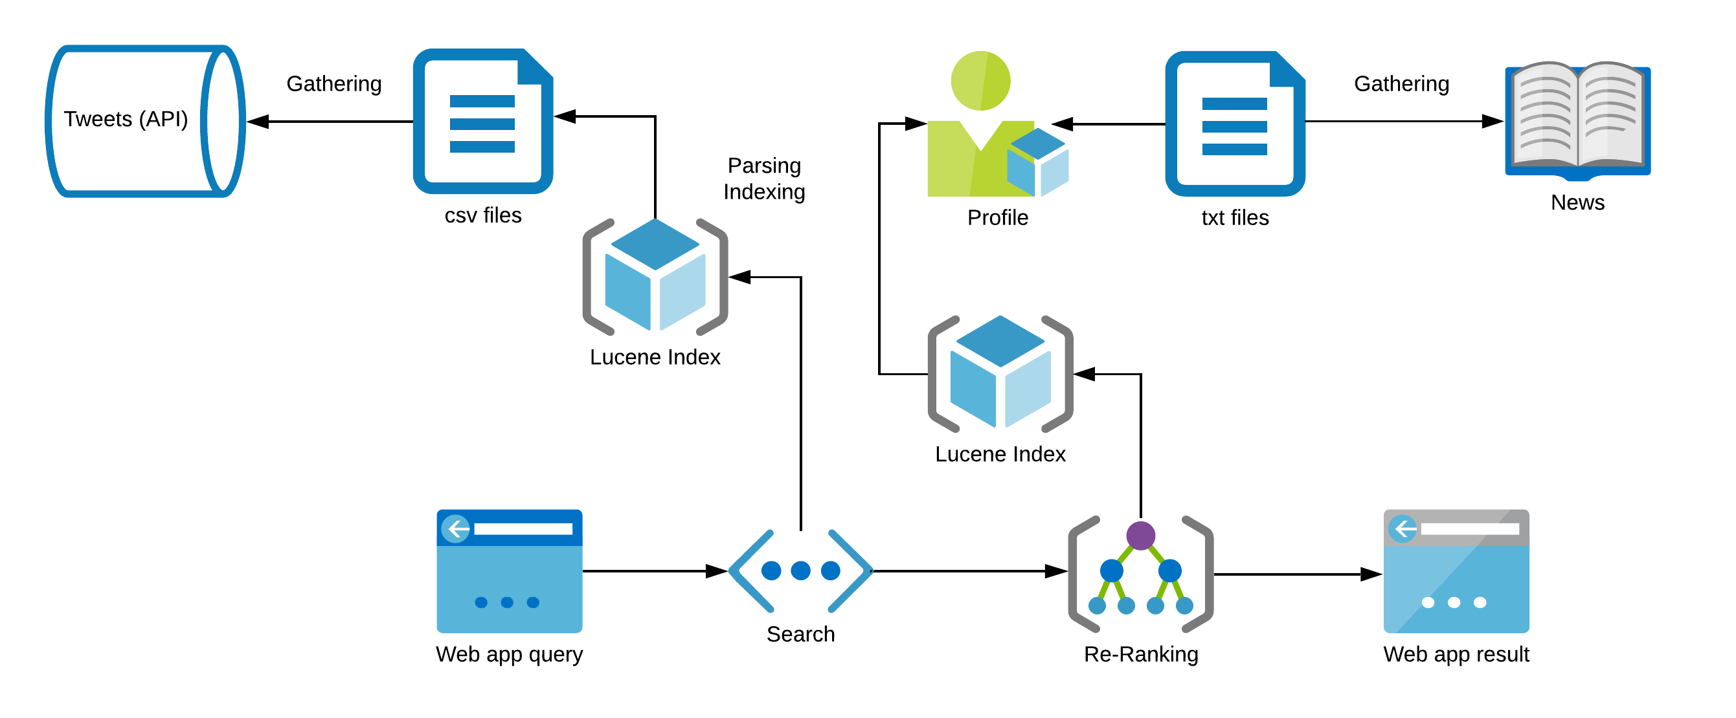
Proposed solution
Architecture

Slide 7
Indexing
Tokenizer
Patterns Replacements
Case Transformation
Stopwords Removal
Stemming
Detailed Steps
Standard Tokenizer
Removed URLs
Lowercase
Porter Stemmer
Unicode UX29 Text

Slide 8


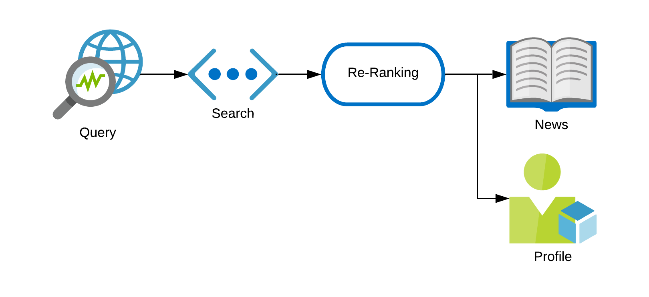
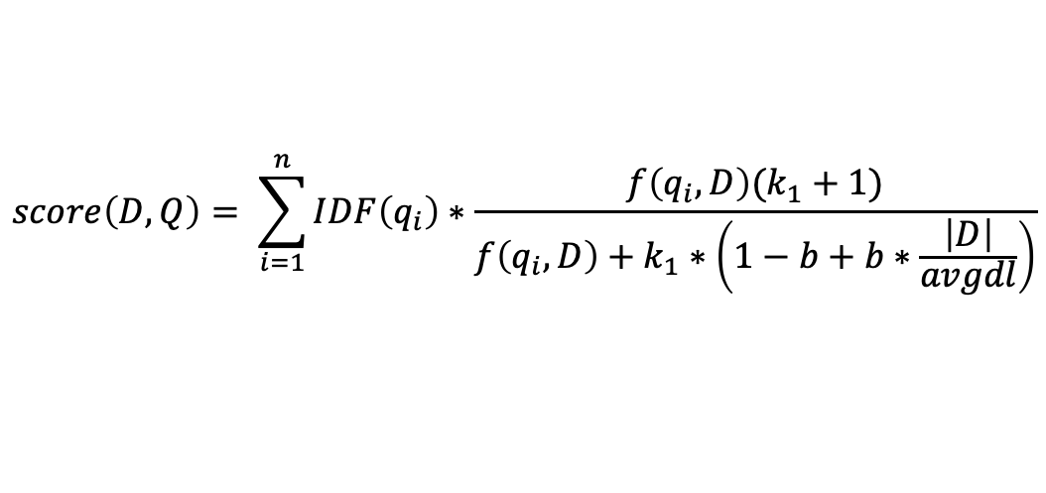
Retrieval and Personalization
Detailed Steps
Retrieval
Personalization
Popularity boosting
Recent documents boosting
Okapi BM25
Cosine Similarity
$$score\left(D, Q\right)= \sum_{i=1}^{n}{IDF\left(q_{i}\right)∗\frac{f\left(q_{i}, D\right)(k_{1}+1)}{f\left(q_{i},D\right)+k_{1}∗\left(1−b+b∗\frac{\left|D\right|}{avgdl}\right)}}$$

Slide 9
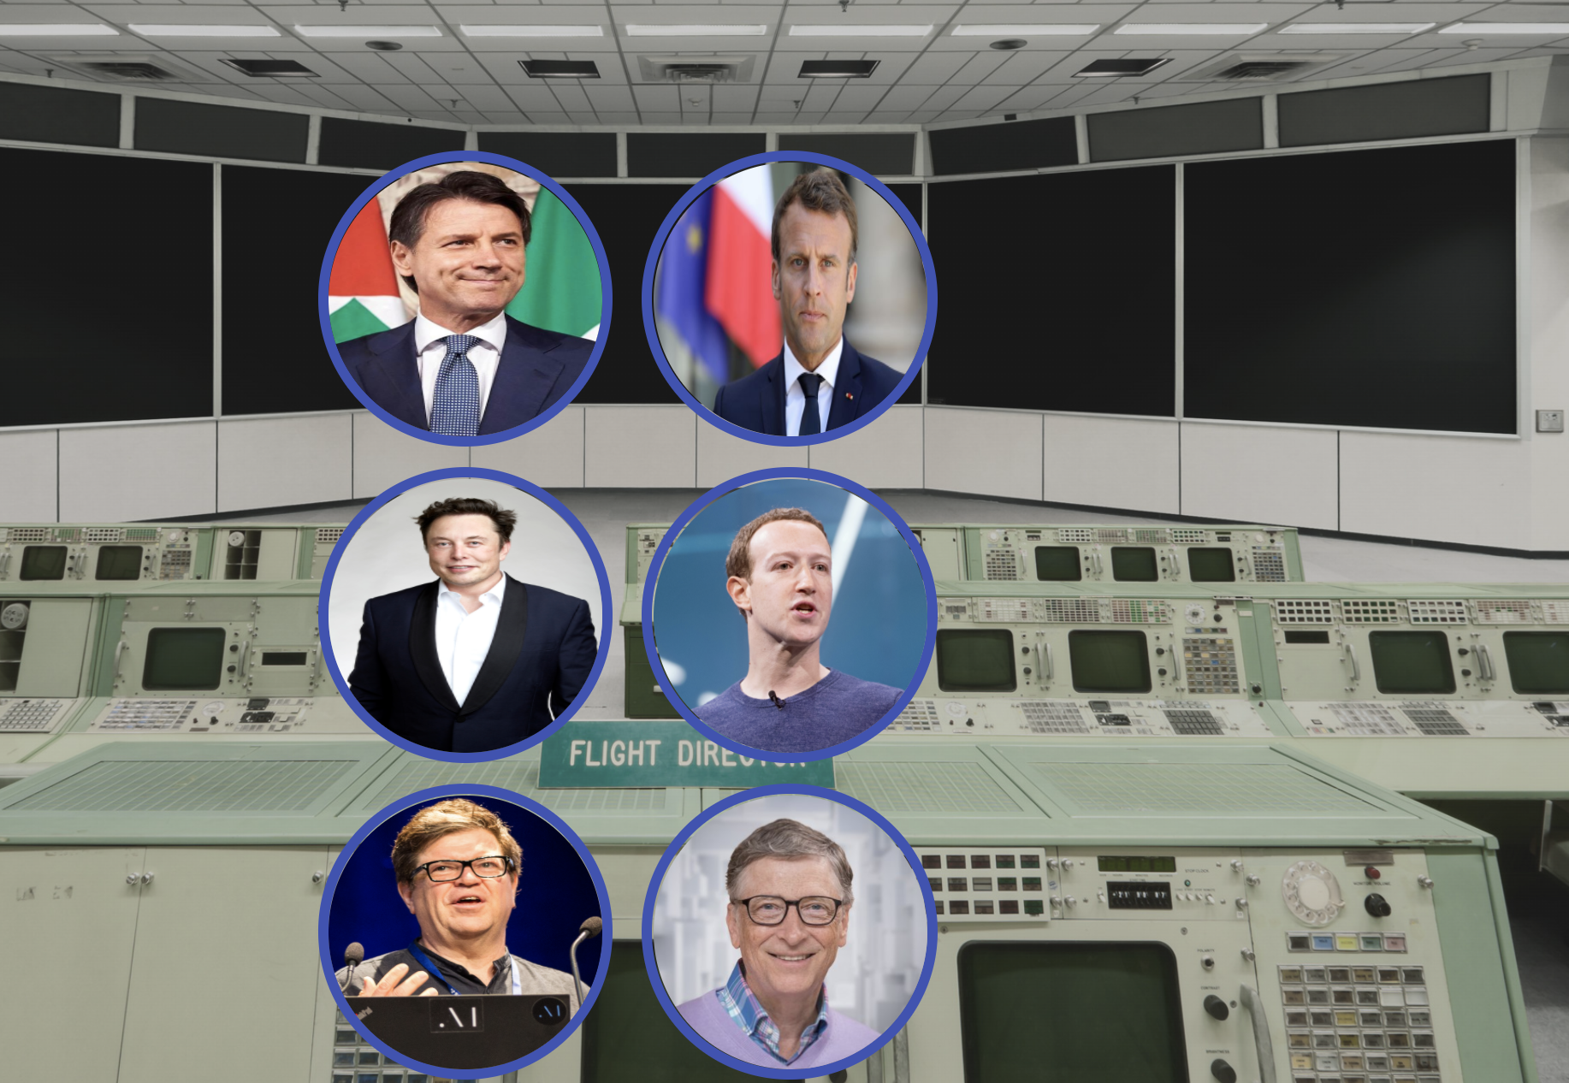
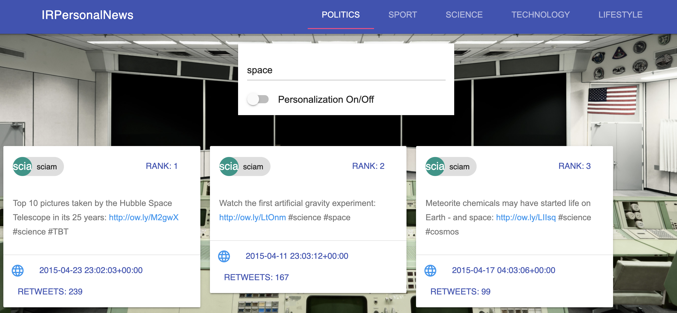





Webapp
Conclusions

Slide 10
Next Steps
Conclusions
Automatization of the pipelines
Much more data
Custom profile creation
Better UI
More robust similarity for personalization

Slide 11
Thanks!

